Slide 1

Job EASY: Simplifying Your Path to Employment
Enhancing Job Matching with Advanced Technologies
Srikar Badugu, Sai Harsha Kotha, Bharadwaj Routhu, Sai Nikhil Gupta Vanaparthy
May 2024

Slide 2

Introduction
Overview of the Job EASY project.
Objectives and goals.

Slide 3

Background
Inefficiencies in traditional job matching.
Role of personality assessments.

Slide 4

Technological Approach
NLP for resume analysis.
Machine learning models: CatBoost and SVM.

Slide 5
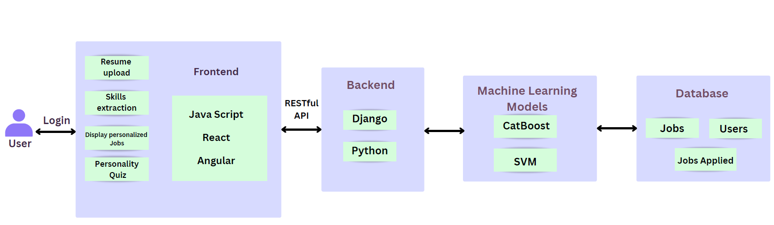
Project Architecture

Slide 6
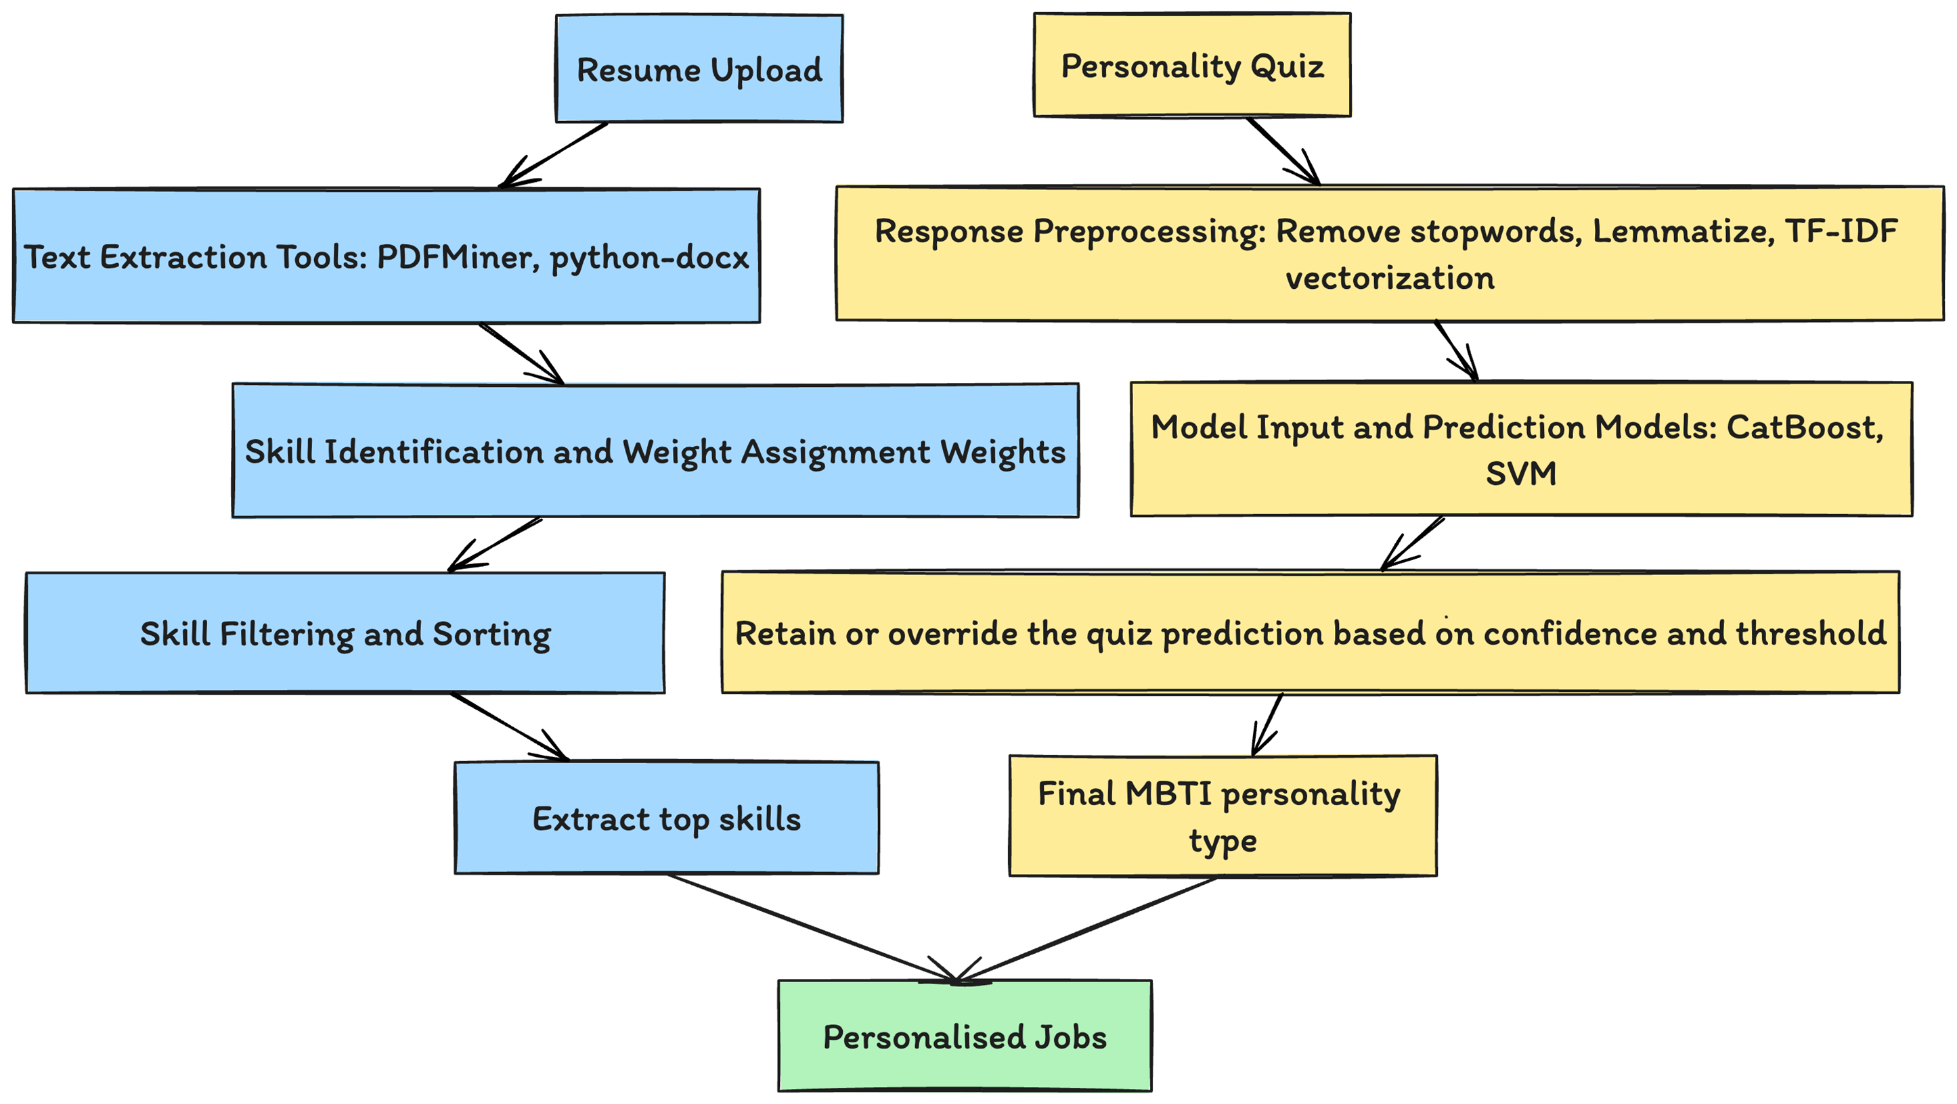
Project Workflow Diagram

Slide 7
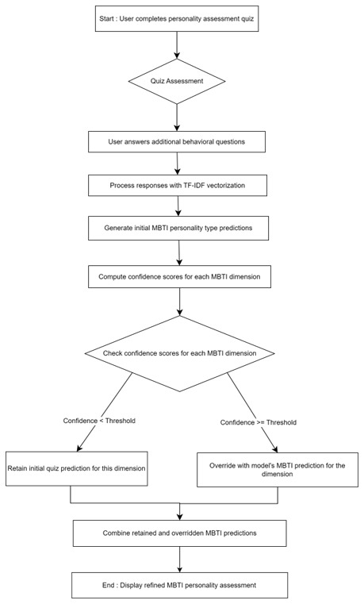
What happens inside the personality prediction quiz?

Slide 8
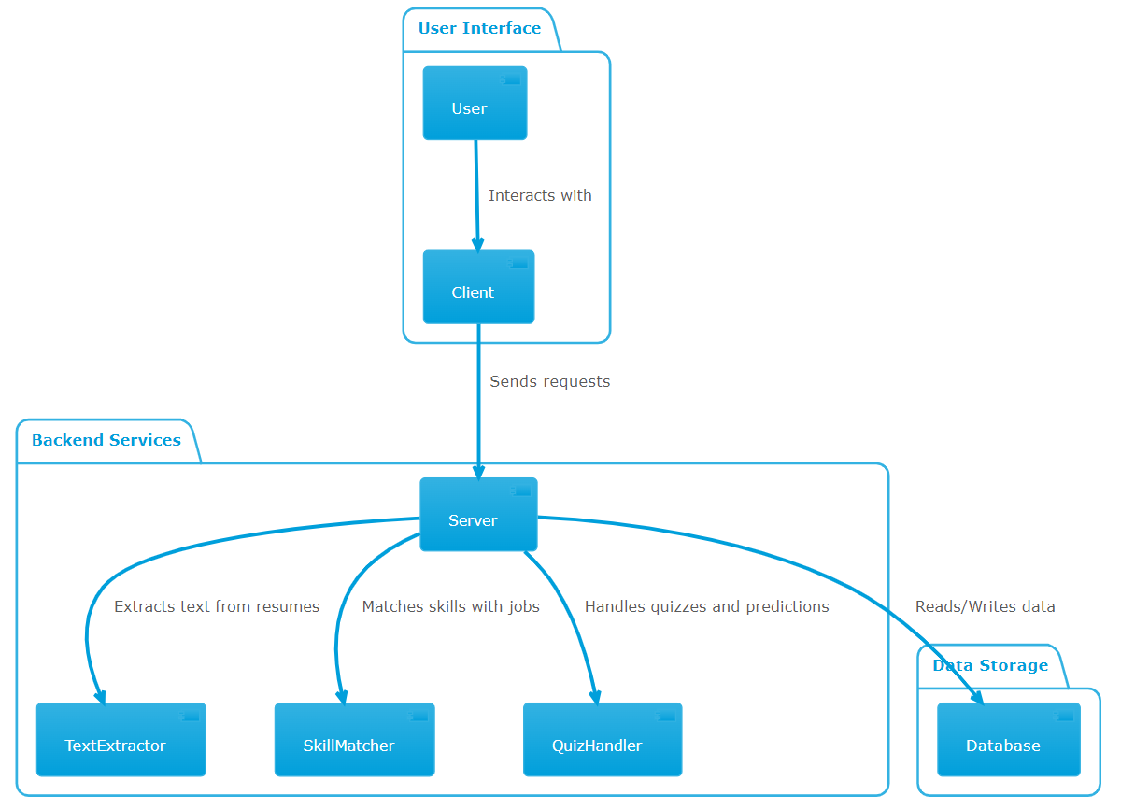
API flow analysis

Slide 9
Skill and Personality Evaluation
Skill weight assignment.
Personality assessment quiz.

Slide 10

Machine Learning Models
Reasons for selecting CatBoost and SVM.
Training process and data imbalance handling.

Slide 11
Implementation Details
Frontend and backend technologies.
Database management.
Security measures.

Slide 12
Deployment, Operations, and Maintenance
Deployment strategy.
Operational support.
Maintenance practices.

Slide 13
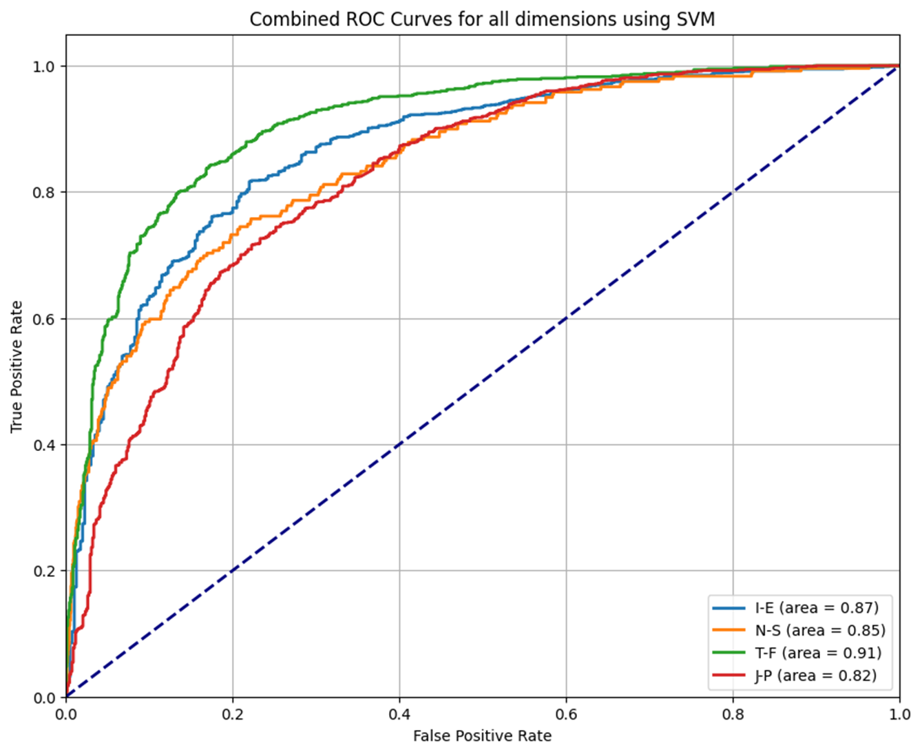
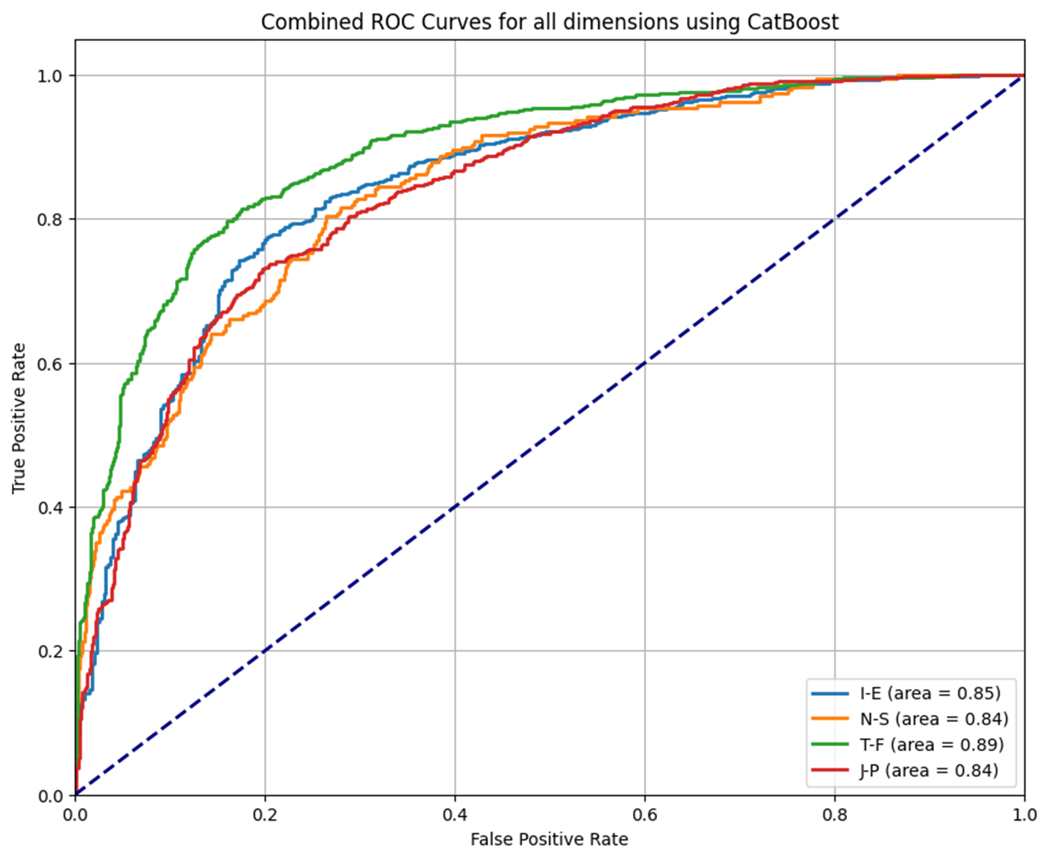
Model Performance Comparison
Combined ROC Curves for all dimensions using SVM
Combined ROC Curves for all dimensions using CatBoost

Slide 14
Summary, Conclusions, and Recommendations
Summary of findings.
Conclusions.
Future recommendations.

